Slide 1
Data Types

Slide 2
Introduction
A data type is a set of values and the allowable operations on those values.
The two fundamental data types in C# are value types and reference types
Primitive types (except strings), enumerations, and structures are value types.
Classes, strings, interfaces, arrays are reference types.
Every type has a default value.
Reference types are created on the Heap.
The lifetime of the reference type is managed by the .NET framework.

Slide 3
The default value for reference types is null reference.
Value types are created on the stack.
The lifetime is determined by the lifetime of the variable.
Assignment to a variable of a value type creates a copy of the value being assigned.
Value types have different default values
For example, boolean default value is false, decimal 0, string an empty string "".

Slide 4
Primitive Data Types
Primitive data types are those that are not defined in terms of other data types.
Because primitive data types are the basis for all other types, they cannot have element content or attributes.
However, they can contain values.
The primitive data types are defined in the System namespace.
Eg: byte, short, int, float, double, long ,char, bool etc.

Slide 5
Composite Data Types
A composite data type is something you can divide into multiple other types.
Box that contains more boxes, if you will. If a box is empty, then it's an elementary data type. attributes.
Eg: Classes, strings, interfaces, arrays etc.

Slide 6
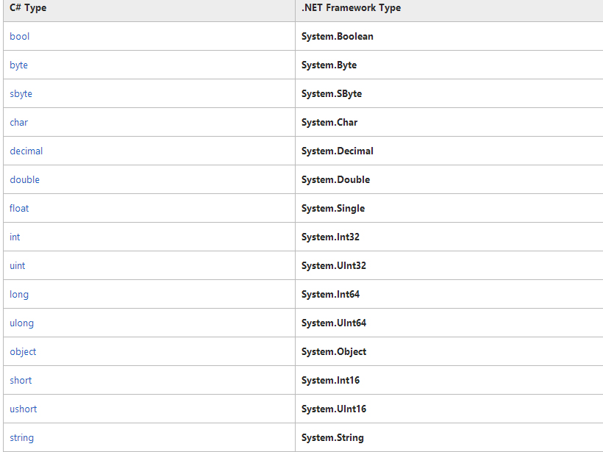

Slide 7
Variables
A variable is an identifier that denotes a storage location in memory .
It stores numeric or string values that might change during the program execution.
A variables may take different values at different times during the execution of a program but the name of variable always remains same.
Every variable has a data type that determine that type of values that can be stored into a variable.
Syntax:
int i;
i=10;

Slide 8
Variable name
Data type
int count = 5;
Variable value

Slide 9
Constants
Constants are also used to store a value.
The value of constant does not change during the execution of a program.
A varaible declare as constant using const keyword.
Syntax:
const double e=2.71532732763;
const int x=100;

